Slide 1


Meet the teacher
Welcome to Ash and Oak
Mrs Lewis, Mrs Webber and Mrs Skeggs

Slide 2
Mrs Lewis
- Qualified in 2001!! (yes I am old)
- Taught my whole career in Central Beds Schools with a couple of breaks to have my children and have been at GMA for 13 years.
- I am passionate about Early Years and giving all children the very best experience of early education.
- I enjoy arts, crafts and being creative.
- I love to be outside and I love my cats.

Slide 3
Mrs Webber
I have taught at Gothic Mede for the past 15 years.
I’ve taught all year groups across the school, spending the past five years in Reception.
I love teaching English and phonics.
I have a daughter who has just started Year 1 and two cats.
I love live music.

Slide 4
Mrs Skeggs
Qualified in 2012.
Taught in Luton for 2 years, took a break to have children, started at GMA at the beginning of 2020.
Favourite things to teach are Maths and History.
Studied Motorsports Engineering at university and love solving puzzles.

Slide 5

Reading Books
Your child will take part in a phonics lesson every day in which we will be introducing letter sounds and names and teaching the key skills of decoding sounds, segmenting and blending. The sounds taught each week will be sent out in the newsletter.
Additionally, your child will be introduced to HRSW (harder to read and spell words).

Slide 6
Reading Books
Your child will have come home with a reading book. These books are inline with our whole school phonics programme. The books are wordless picture books. Enjoy the story together and encourage your child to tell you about what is happening in the pictures, predict what might happen next and discuss anything that the story might remind you of. Books will be changed every Friday and we encourage you to re-read the book with your child at least 3 times throughout the week. Please record each time you read in their reading record diary. If no entries are made we will assume the book has not been read and it will not be changed. Please keep the book in your child's book bag so that it is available if an adult in school needs to listen to them read.

Slide 7
Library
Your child will visit the library every two weeks where they will be able to select a book to take home. These sessions will be on a Tuesday. Please ensure your child’s library book is in their book bag on Tuesdays so that they are able to select a new one.

Slide 8
Homework
Daily reading and practising the HRSW
Each half term, your child will receive a topic based task and a maths based task. These will be shared with you in the newsletter and should be submitted on Tapestry for us to see and for your child to share.

Slide 9
Tapestry
Tapestry is an online Learning Journal that we use in Early Years (Nursery and Reception) to record the children’s learning. We will be uploading photos and observations that we take of the children. You can access these and upload your own photos of the children showing their learning at home (as well as their half termly homework).
You should have received an activation email for Tapestry. If you have not please contact the school office.
You will see some observations of your child over the course of the year however the emphasis is on high quality interactions in order to move their learning on.

Slide 10
Weekly Newsletters, Social Media and Website
Every fortnight we will send out a newsletter, via e-mail which may include:
  A summary of what the children have been learning in the previous weeks, in both adult led activities and their free play;
  Information on what the children will be learning about so that you can support your child’s learning at home;
  Other important information and reminders, for example, if there is a special event happening that week at school.
These newsletters can also be accessed on our class page on the school website which also has lots of other helpful information.
Follow us on Facebook and Twitter – Gothic Mede Academy

Slide 11
Snacks and Water bottles
Please ensure your child brings a water bottle to school each day - this should only contain water (no juice please!).Please name the bottle.
Their morning snack can either be purchased from the school kitchen or sent in from home. Snacks sent in from home need to be named. Please only send in one or two as they have lunch at 11.30am. If you order a snack from the kitchen you do not need to send one in from home.
In the afternoon, your child will receive a piece of fruit.

Slide 12
Uniform
Please make sure all uniform is CLEARLY named and make a point of checking this regularly in case the name has faded. Any uniform that is found and has not got a name on will be put in lost property. If your child has long hair, then please ensure it is tied back every day. Jewellery (excluding earrings), nail varnish and temporary tattoos are not permitted.

Slide 13
P.E.
Ash and Oak classes have P.E. on a Tuesday.
Please ensure you send your child in wearing P.E. kit on Tuesdays.
As the weather gets colder it is advisable that your child wears jogging bottoms and has a jumper with them as P.E. will still take place outside on some days. Please ensure that ALL P.E. kit is named. Earrings should not be worn on P.E. days.

Slide 14
Forest school
Your child will attend Forest school fortnightly on Mondays. (Mondays are not PE days as it was stated in the newsletter).
Next week, it will be Oak class’ turn and the following week will be Ash. Please ensure that your child is wearing the following:
• Outdoor shoes – walking boots, old trainers or wellingtons
• Warm socks
• A warm, waterproof coat
• A jumper or fleece
• A t-shirt
• Trousers
• Waterproof over-trousers if possible
• An extra layer of clothing depending on the weather. It goes without saying that it’s a great idea to put your child’s name in all of their clothing!
Please note these need to be old clothes from home and not school uniform. The spare clothes also need to be from home and not school uniform.
Your child will not need to bring their bookbag on this day.

Slide 15

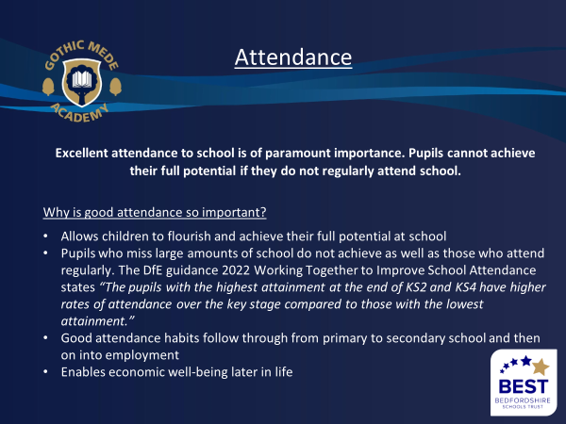

Slide 16
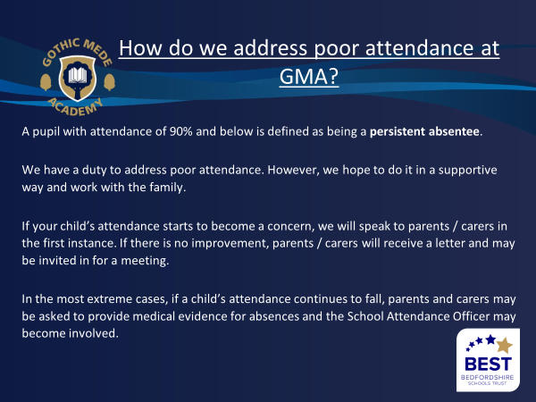

Slide 17
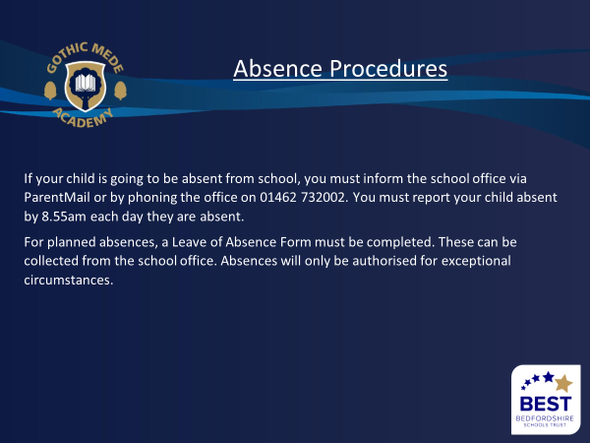

Slide 18
End of the day
Please ensure you notify school if someone else is collecting at the end of the day.
Please be aware that after school club, although part of BEST is not part of Gothic Mede and any queries need to be raised directly with them.

Slide 19
What’s new at GMA this year?
-Continuing to increase pupil attainment
-Increase understanding of how we manage behaviour
-Increase our financial position
-Increase the use of parent voice as part of the school improvement process
-Create a multi-layered approach to good staff wellbeing

